Slide 1
Common Print Dialog Backends
Till Kamppeter – OpenPrinting
September 20, 2021

Slide 2
The problem
To control printing, GUI applications use print dialogs
Many different print dialogs, usually from the GUI toolkit used (GTK, Qt, …)
Each one has its own implementation to connect to CUPS, Print-to-File, and other print technologies
Print dialog development does not keep up with changes, like temporary queues in CUPS, or addition of a new print technology (cloud service, ...)
  Printing not considered very important
  Newly introduced print technology not considered worthwhile
  Developers do not have time
  Long release cycles of GUI toolkit projects vs. fast pace in printing development

Slide 3
The idea
Long time ago we tried a Common Print Dialog, but failed due to lack of human resources and/or funding
Later we Aveek Basu remembered this project suggested a revival, but I was unsure.
Fixing a CUPS-related bug in the GTK print dialog I discovered that it uses backends for different print technologies
All this brought up the idea of Common Print Dialog Backends in me:
  Dialog itself still from the GUI toolkits (GTK, Qt, LibreOffice, ...)
  GUI-independent backends for each print technology (CUPS, Print to file, …)
  Connection Dialog ↔ Backend: D-Bus (separately sandboxable)
  Backend and frontend libraries

Slide 4
The idea
  Backends maintained by maintainer of print technology
    CUPS backend: OpenPrinting
    GlobalCloud Print backend: GlobalCloud
    …
  Print dialog detects installed backends and shows the printers of the respective print technologies
  User sees always the same printers with the same user-settable options in all print dialogs (GTK, Qt, LibreOffice, …)
  Print service provider can supply backend via Snap Store
  Maintainer of print technology changes something → He issues backup update and all print dialogs are up-to-date

Slide 5
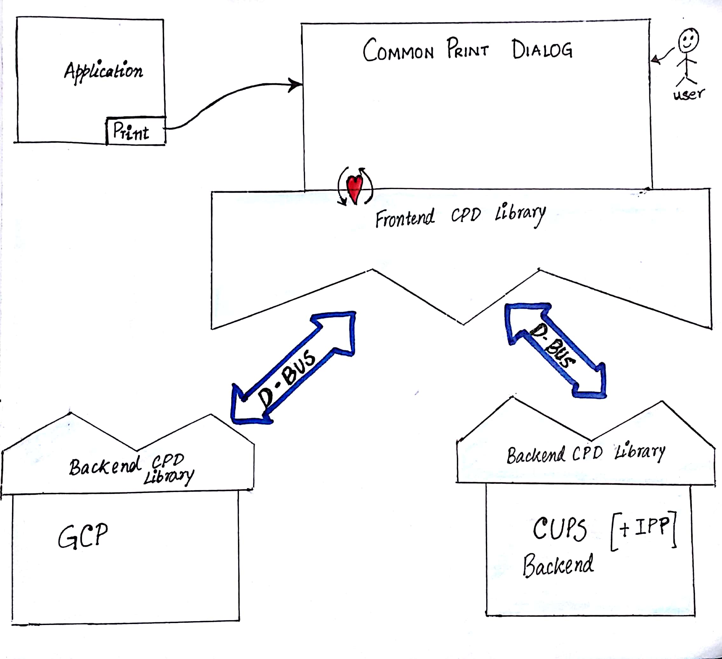
The implementation
I posted this a project idea in the Google Summer of Code 2017 …
… and Nilanjana Lodh picked it up and implemented it (her original drawing):

Slide 6
The Implementation
Libraries are on the OpenPrinting GitHub
  Frontend/Backend libraries: cpdb-libs
  CUPS backend: cpdb-backend-cups
  Print to file backend: cpdb-backend-file
There are also packages in Ubuntu (Universe)

Slide 7
The new problem
No one did a frontend implementation to submit to the GUI toolkit projects GTK and Qt yet.
This could save us from problems like
  CUPS added the new cupsEnumDests() API to support its temporary queues many years ago, GTK switched to it this year, Qt did not switch yet.
  The architecture of CUPS will significantly change with version 3.0 ...

Slide 8
Questions / Comments

